Slide 1
Concurrent Processes: Synchronization & Deadlocks Module 8
Operating Systems
Nadia Qureshi

Slide 2
Chapter Outline
Concurrent processes
Cooperating Processes
Resources
Race condition
Deadlock
Atomic Operations
Synchronization
Critical section
Mutual Exclusion
Synchronization Requirements

Slide 3
Outline
The Critical-Section Problem
Hardware Support for Synchronization
Mutex Locks

Slide 4
Concurrent Processes
Many processes can be executed concurrently to perform multitasking on a CPU due to following reasons
To share system resources in a multi-user environment
To share data/database
To breakup a task into subtasks, each execute in parallel
Parallel execution of tasks like editing, spell checking, printing and compiling
In concurrency, the issues of cooperation among the processes, synchronization and communication are very important
Such a process has the following characteristics
Its state is shared among other processes
The result of its execution cannot be predicted because of relative execution
The result of its execution is non-deterministic
Concurrent access to shared data may result in data inconsistency
Maintaining data consistency requires mechanisms to ensure the orderly execution of cooperating processes

Slide 5
Cooperating Processes
Cooperating Process: A process is cooperating if it can affect or be affected by the other processes executing in the system
We provide an environment that allows process cooperation due to following reasons
Information sharing
Many users or processes may be interested in the same piece of information
Computation speedup
We breakup process into subtasks which run in parallel
Modularity
We want to construct the system in modular fashion, dividing the system functions into separate threads
Convenience
A user can do editing, printing and compiling in parallel

Slide 6
Resources
There are two types of resources;
Reusable resource
This resource is not destroyed by being used, e.g. processor, memory etc
Space multiplexed resources can be divided into two or more distinct units at the same time. E.g. RAM, Disk etc
Time multiplexed resources cannot be divided into units. E.g. processor
Consumable resource
This resource is a transient data item or a signal which is created by one process and ceases to exist when received by another process. E.g. messages

Slide 7
Race Conditions
It is a situation in which several processes access and manipulate shared data concurrently and the final value of the shared data depends upon which process finishes last
It is very common in concurrent processes, as they often share some common storage that one can read or write
To prevent race conditions, concurrent processes must be synchronized (using semaphores, Peterson solution, locks)
Consider the following two processes accessing the same shared variable int shared =5
int shared = 5
P1 int x = shared; x++; Sleep(1); Shared = x; | P2 int y = shared; y--; Sleep(1); Shared = y;

Slide 8
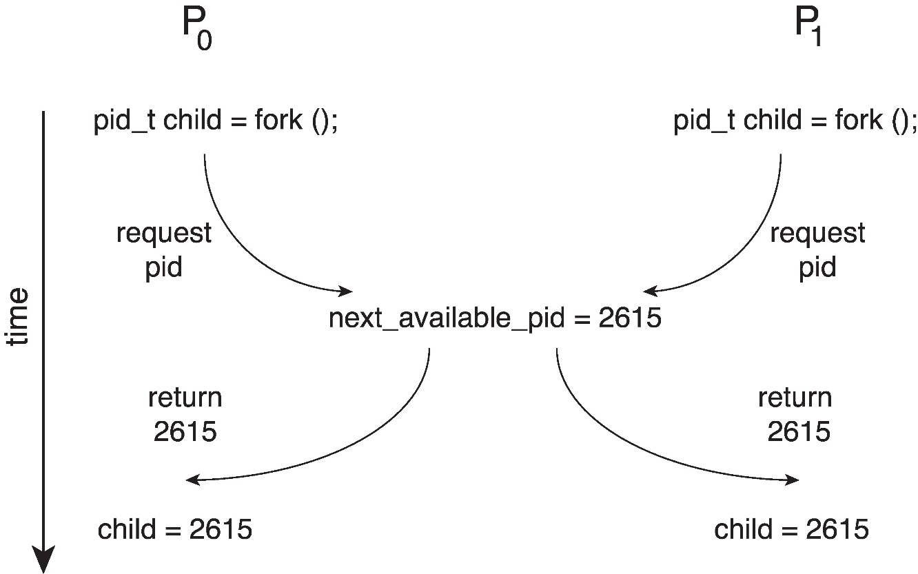
Race Condition
Processes P0 and P1 are creating child processes using the fork() system call
Race condition on kernel variable next_available_pid which represents the next available process identifier (pid)
Unless there is a mechanism to prevent P0 and P1 from accessing the variable next_available_pid the same pid could be assigned to two different processes!

Slide 9
Deadlock
In a multiprogramming environment, several processes may compete for one or more than one resources
A process request for a resource and if that resource is not available at that time, the process enters a wait state
The waiting state of a process may prolong for infinite period due to non-availability of that resource
This situation is called deadlock

Slide 10
Deadlock
Deadlock occurs when processes have been granted exclusive access to devices or files
A resource can be hardware device (printer, processor, tape, disk) or a piece of information (a locked record in database)
In general, deadlock involves non-preemptable resources
The sequence of events required to use a resource are;
Request the resource
Use the resource
Release the resource
If the requested resource is not available, the process is forced to wait

Slide 11
Deadlock Characterization
Mutual exclusion
only one process at a time can use a resource
Hold and wait
a process holding at least one resource is waiting to acquire additional resources held by other processes
No preemption
a resource can be released only voluntarily by the process holding it, after that process has completed its task
Circular wait
there exists a set {P₀, P₁, …, P₀} of waiting processes such that P₀ is waiting for a resource that is held by P₁, P₁ is waiting for a resource that is held by
P₂, …, P_{n–1} is waiting for a resource that is held by P_{n}, and P₀ is waiting for a resource that is held by P₀

Slide 12
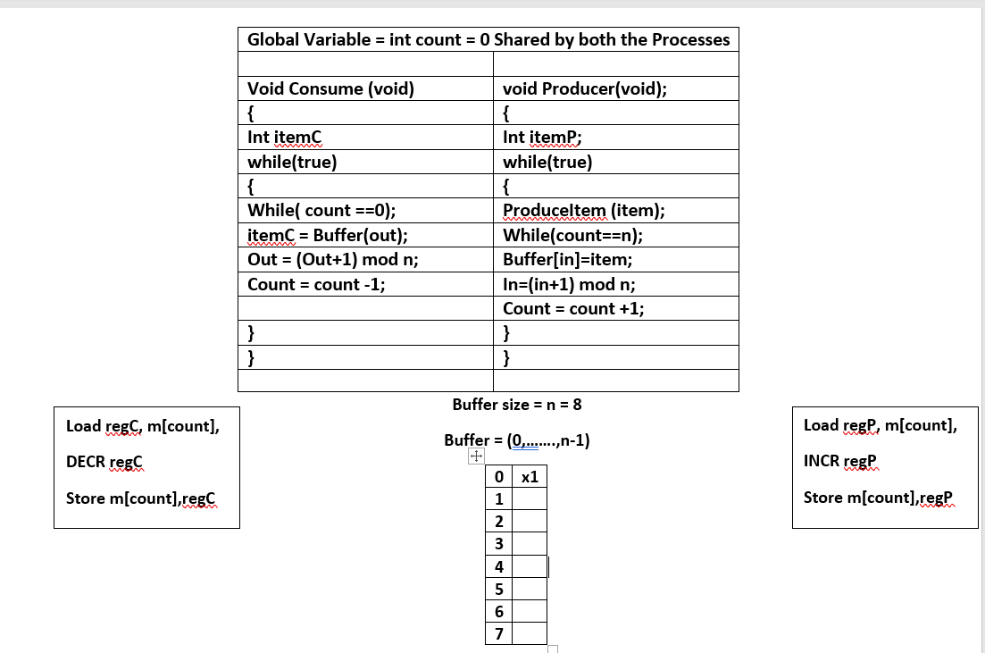
Producer Consumer Problem
-While buffer overflow, while true control would stuck into an infinite loop due to ; at end
-In points to empty position address in the buffer to insert item x1. in=0 at first
-0+1 mod 8 = 1 so in = 1
mod is used because when value reaches 7 it starts to 0 in the next instruction 8mod8=0
-Increment count representing no.of items in buffer
While buffer empty the control would stuck into infinite loop due to ;
In points to empty position address in the buffer to insert item x1. in=0 at first
0+1 mod 8 = 1 mod 8 so in = 1
decrement count representing usage of item from buffer
Out =0 then 1
Count =1 then 0
In =0 then 1
Count =0 then 1

Slide 13
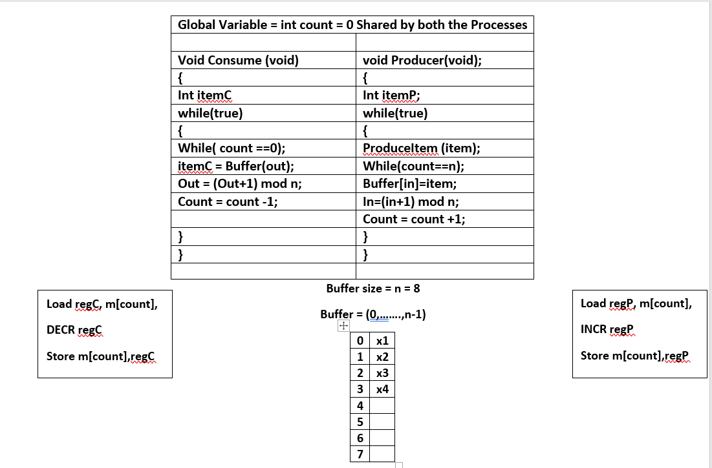
Producer Consumer Problem (preemption example)
Producer I1,I2,
Consumer I1,I2,
Producer I3,
Producer Terminated
Consumer I3
Out =0 then 1,2
Count =3 then 2
In =4
Count =3 then it was updated as 4 after execution of Producer I3 execution

Slide 14
Atomic Operations
Operations that cannot be interrupted
We never see any part of the effect of an atomic operation unless we see all effect
We cannot see the operation in-progress
Atomic operations are also relevant outside operating system too
The hardware also provide atomic operations
E.g
A single load or store instruction
A test and set instruction
Atomic Operations | Non-Atomic Operations
Turn off the light | Fill a glass of water
Break a window | Walk to the door

Slide 15
Synchronization
Synchronization is the process in which we accommodate the multiple concurrent processes competing for the same resource
Synchronization is achieved with the help of some mechanisms
Mutual exclusion
Only one thread does something at one time onto shared data
E.g ; do not read a variable while somebody else is writing it
Critical section
A section of code or a collection of operations in which only one thread may be executing at a given time

Slide 16
Critical Section
Part of the program where shared memory is accessed is called critical section, or
The area of a process which is sensitive to inter-process complications is called critical section or critical region
Following are the four conditions to hold for a good solution
No two processes may be simultaneously in their critical sections
No assumptions may be made about speeds or number of CPUs
No process running outside its critical section may block other process
No process should have to wait forever to enter in its critical section

Slide 17
Critical Section Problem
Consider system of n processes {p0, p1, … pn-1}
Each process has critical section segment of code
Process may be changing common variables, updating table, writing file, etc.
When one process in critical section, no other may be in its critical section
Critical section problem is to design protocol to solve this
Each process must ask permission to enter critical section in entry section, may follow critical section with exit section, then remainder section

Slide 18
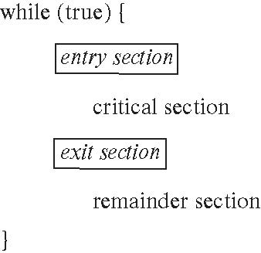
Critical Section
General structure of process Pi

Slide 19
Mutual Exclusion
A condition in which there is a set of processes, only one of which is able to access a given resource or perform a given function at any time
Suppose two or more processes require access to a single non-sharable resource, such as printer
Each process will be sending data to the printer through critical section of each process
It is important that only one program at a time be allowed in its critical section
One cannot rely on operating system to enforce this restriction, therefore the processes have to be controlled

Slide 20
Solution to Critical Section Problem
Requirements for solution to critical-section problem
Mutual Exclusion
If process Pi is executing in its critical section, then no other processes can be executing in their critical sections
Progress
If no process is executing in its critical section and there exist some processes that wish to enter their critical section, then the selection of the processes that will enter the critical section next cannot be postponed indefinitely
Bounded Waiting
A bound must exist on the number of times that other processes are allowed to enter their critical sections after a process has made a request to enter its critical section and before that request is granted
Assume that each process executes at a nonzero speed
No assumption concerning relative speed of the n processes

Slide 21
Synchronization Requirements
Requirements for a mutual exclusion primitive
Must allow only one process into a critical section at a time
If several requests are made at once, must allow only one process to proceed
Processes must be able to go on vacations outside critical region
Desirable properties for a mutual exclusion mechanism
Fair
If several processes are waiting, let each in eventually
Efficient
Do not use substantial amount of resources when waiting. In particular busy waiting
Simple
Should be easy to use

Slide 22
Synchronization Requirements
Desirable properties for threads using mechanism
Always lock before manipulating shared data
Always unlock after manipulating shared data
Do not lock again if you have already lock it
Do not unlock if you did not lock it
Do not spend large amount of time in critical section
In general we use locks and condition variables

Slide 23
Mutex Locks
OS designers build software tools to solve critical section problem
Simplest and oldest method is mutex lock
Boolean variable indicating if lock is available or not
Protect a critical section by
First acquire() a lock
Then release() the lock
Calls to acquire() and release() must be atomic
Usually implemented via hardware atomic instructions such as compare-and-swap.
But this solution requires busy waiting
This lock therefore called a spinlock

Slide 24
Solution to CS Problem Using Mutex Locks
while (true) {
acquire lock
critical section
release lock
remainder section
}

